Slide 1
CTO Community of Practice (CCoP) Session
LEARNING
KRONOS TIMEKEEPING ‘101’
November 21, 2024

Slide 2
Welcome to Today’s CCoP Session!
Zoom Tips & Reminders:
Switch from Full Screen View to Partial Screen View by pressing ESC.
You can change your Zoom Name by viewing the Participants in the meeting.
Communicate with the Host or with other members by using the Chat feature.
To make speaker, interpreter, or shared screen larger choose Switch Screen on top right hand side of speaker box
Please remember to Mute your microphone during a presentation and always be mindful of your surroundings when your camera is enabled. Click the ^ icon to change your audio and video settings.

Slide 3
Good to knows!!!
Interpreter will be spotlighted & Interpretation feature is turned on
Recordings and future trainings available on our website https://www.rit.edu/controller/community-practice
Please take the short survey that will be provided in chat to give us valuable feedback!
https://rit.az1.qualtrics.com/jfe/form/SV_eD2AGwEuq4A7Lf0
Let’s meet the SMEs for today!

Slide 4
Timekeeping 101 Agenda
Payroll, Timekeeping & RSC Partners
Importance of Proper Timekeeping
Timecard Overview
Compliant Practices
Audit Flags
Kronos Audit Tab
Kronos Access & Recording Methods
Timekeeping Notifications
Resolving Common Issues
Additional Resources
Holiday Reminders

Slide 5
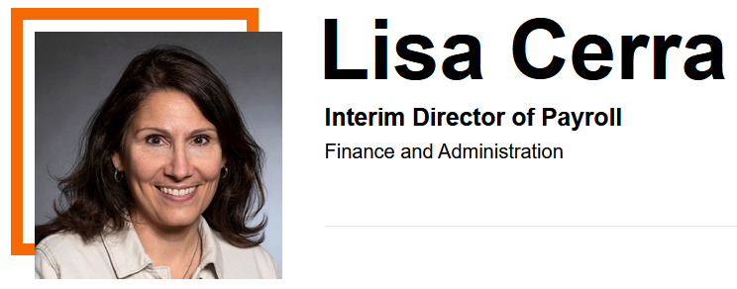
Payroll Partners

Slide 6
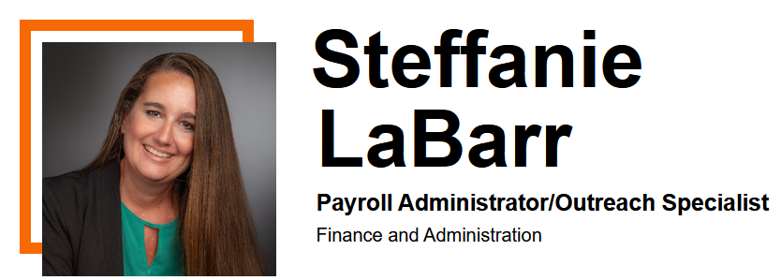
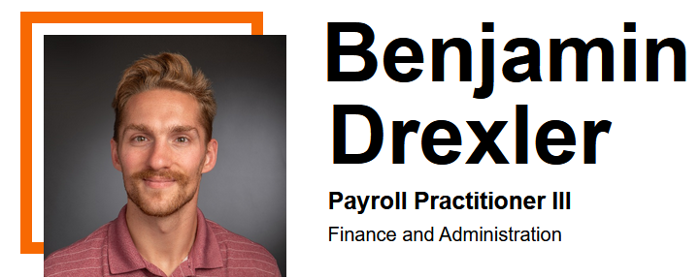
Payroll Partners

Slide 7
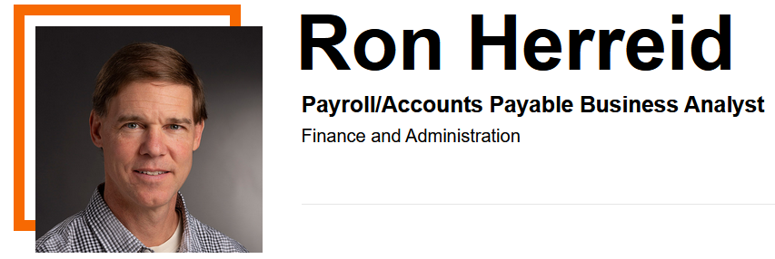
Kronos Gurus

Slide 8
RSC: One Stop Shop for Timekeeping
https://help.rit.edu
(585) 475-5000
Expert assistance
KBAs – knowledge base articles

Slide 9
Importance of Proper Timekeeping
Timely, accurate paychecks
Federal & state regulations (FLSA, etc)
PTO tracking & accrual balances
Informs budgetary decisions & metrics
Built in internal controls & audit functions

Slide 10
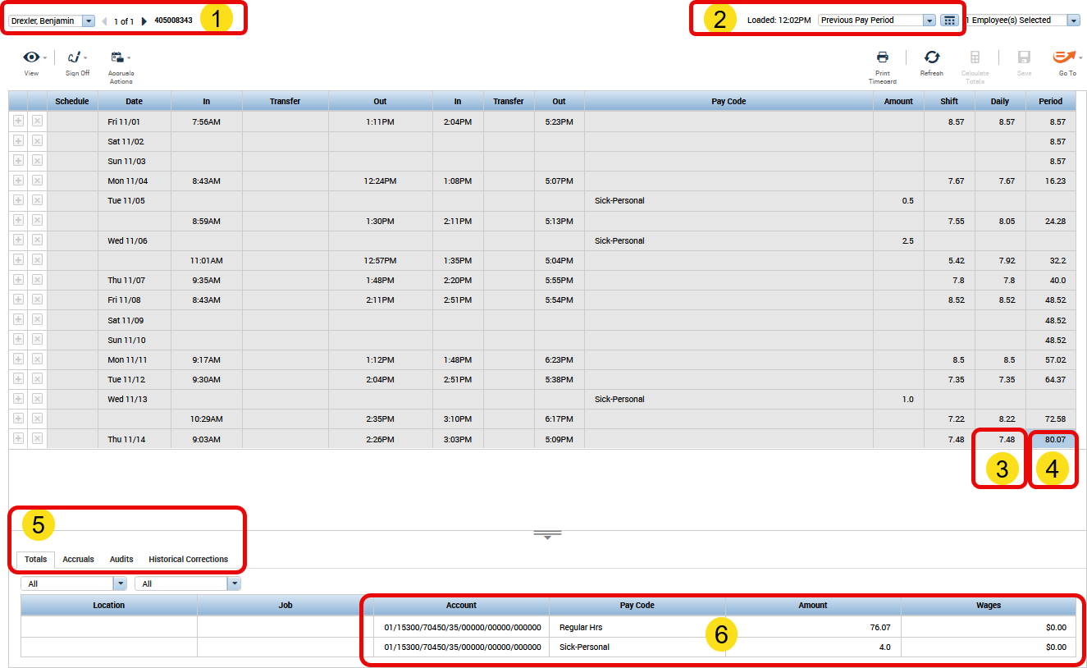
Timecard Overview
KEY:
1-Name
2-Pay period
3-Daily total
4-Period total
5-Tabs
6-Summary
Slider Bar

Slide 11
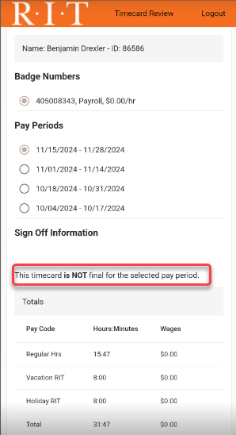
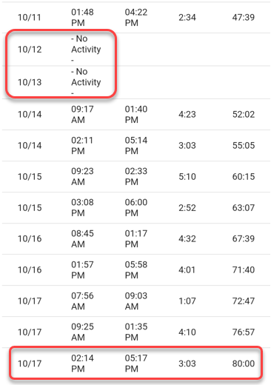
Timecard Review App
App for Employees
RIT Timecard Review App
If you punch at a clock, use the app to verify your time

Slide 12
Compliant Practices
Recording Your Time
Enter punches in ‘real time’
Record exact start & end times…to the minute!
Punch in & out for meal periods
24-hour day of rest required
Take 30-min meal break between 11am & 2pm for daily shifts >6 hrs
NYS Dept of Labor - Day of Rest & Meal Periods

Slide 13
Compliant Practices
Kronos Supervisors:
Review timecards throughout pay period
Sign-off every other Friday: Kronos Signoff Schedule
Verify accuracy before sign-off
Managers who delegate remain responsible for oversight
Stay informed & engaged; timecard access recommended
Ensure compliance & address discrepancies promptly
Recordkeeping: retain backup on file share for 3 years
Legal Affairs Document Retention Guidelines
Be a Timekeeping Ambassador

Slide 14
Audit Flags
Missing or late meal breaks
Persistent rounding
Canned punches
Entering punches all at once
Excessive edits
Time entries when off the clock

Slide 15
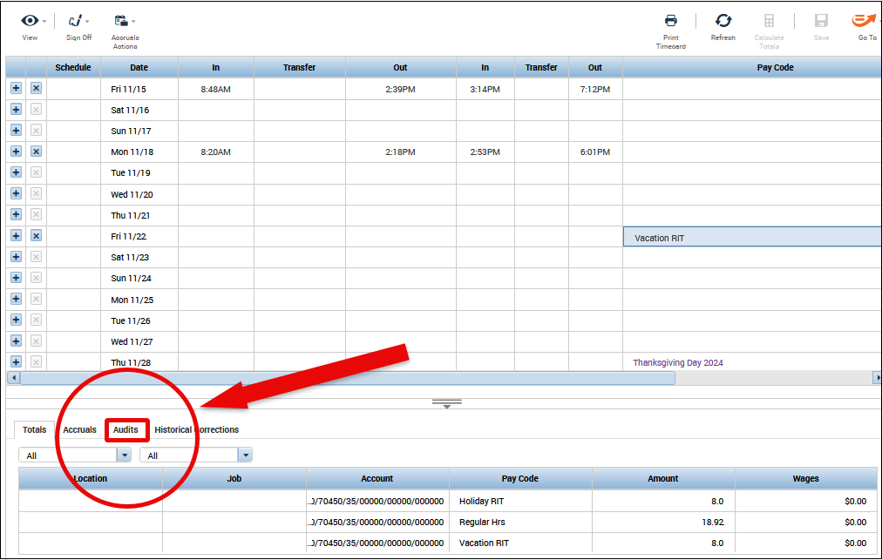
Kronos Audit Tab
Useful resource:
The audit tab is located at the bottom of timecards

Slide 16
Questions

Slide 17
Kronos Access & Recording Methods
STAFF
Kronos Self-Serve Access Request
Allows editing of time and entry of vacation & sick absences
Timeclocks on Campus (60+ locations)
Method of access determined at department level
STUDENTS
Access is granted as part of the student hire process
Timeclocks on Campus
RIT Online Timeclock App (web application for on-campus workers)
Pilot: Kronos Quick Time Stamp (for remote student workers)
Solution for managing large groups: email payroll@rit.edu if interested

Slide 18
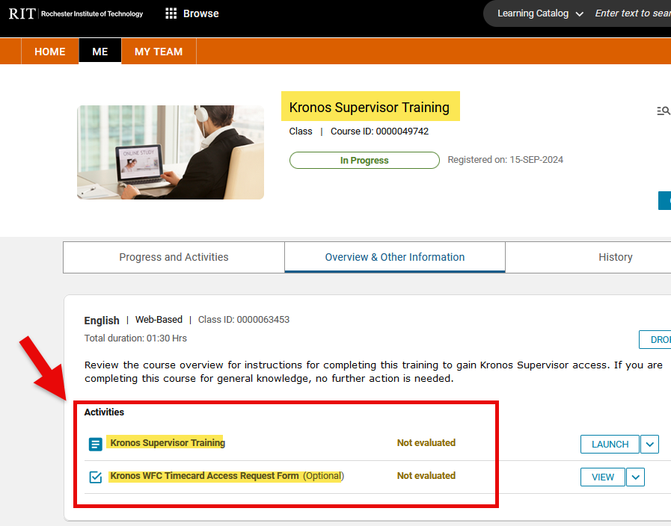
Supervisor Access
Kronos Supervisor Training – Talent Roadmap RIT
Other Important Links:
How to create a shortcut for Kronos access
General Kronos FAQs

Slide 19
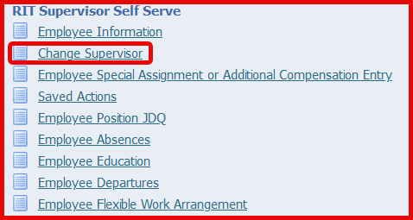
Timekeeping Notifications
Notification | Pertains To
Missing Punch | Students
Overlapping Punch | Students
Long Shift | Staff/Students
Signoff Reminder | Staff/Students
Timecard Violation | Staff/Students
All notifications emailed to supervisors
To change Staff supv: RIT Supervisor Self Serve
To change Student supv: studentemployment@rit.edu

Slide 20
Resolving Common Issues
Helpful Links
Request to Remove Signoff
Payroll Change Form for Staff
Payroll Change Request for Students
Payroll Tip Sheets
Payroll Change Requests for Students Video
What if I Can’t See a Timecard in Kronos?
How to View a Termed Timecard
For new employees, complete the hire process first; otherwise, contact the RSC
How does my new employee get set up in Kronos?
Paid Sick Leave (PSL) for Students with Multiple Jobs
Full PSL balance is available to enter through each timecard
Payroll audits/corrects for overuse each pay period

Slide 21
Additional Resources
RIT Payroll Resources
Payroll Forms & Resources
Payroll Schedules
Controller’s Office Training Videos
Self Requesting Oracle Access (for online student payroll changes)
How to Sign Up for Direct Deposit
Accessing Paystubs
IACA Quaestor Newsletter - Volume 19, Issue 2
Importance of Timekeeping by Ellen Fustanio
RIT Talent Roadmap – watch for upcoming Employment Law training
RIT Service Center (RSC)
Timecard Conversion - Decimals to Minutes

Slide 22
Holiday Reminders
HOLIDAY EARLY RELEASE
2pm Wed, 11/27
2pm, Tue 12/24
Early release days: employees receive 3 hours of Approved with Pay
Holiday Early Release FAQs

Slide 23
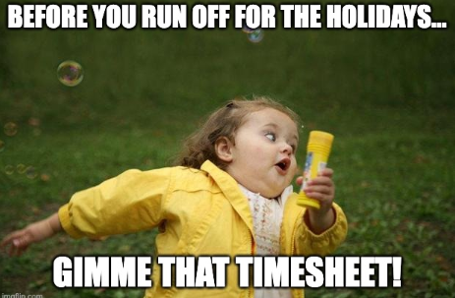
Holiday Reminders
Payroll will approve all holiday timecards:
Signoff Friday, 11/29 (for PE 11/28)
Signoff Friday, 12/27 (for PE 12/26)
Supervisor Actions:
Add Approved w/Pay for early releases
Add holiday for part-timers
Review cards for accuracy before & after holiday
Submit payroll changes upon return if necessary

Slide 24
Thanks so much for your…TIME! ☺
QUESTIONS?

